Slide 1


Utilizing Stock Signals to Predict Future Price “If you want to have a better performance than the crowd, you must do things differently from the crowd” - Sir Johnson Templeton
Jeremy Radcliffe, Levi Christian, Bill Udeh

Slide 2

Stock Trading Model Overview
Utilizing industry standard leading and lagging indicators as feature inputs to our model, we sought to assess their impact on returns.
Our system evaluated 3yrs of historical data consisting of daily close prices of the S&P500 index as compared to our Neural Network model.
Allocating an initial investment of $10,000 over a 1yr trading period, our model endeavored to predict next days price and produce positive returns based on the previous day's signals.

Slide 3
Data Sources and Python Packages
Alpaca sourced Daily Close Price Data for:
S&P500
Python Packages:
Pandas
Numpy
Joblib
Tensor Flow
Sklearn

Slide 4
Trading Model Summary
Model Check
Neural Network model utilizing five (5) stock indicators as features: Bollinger Bands, MACD, RSI, RSI Signal, and EMA Crossover Signal benchmarked against the S&P500.
Target
Our model utilized Positive Returns as the Target to determine the success of making accurate predictions.
Depending on predictions our model could go either long or short.
Results
While the model accuracy score was low, cumulative returns primarily matched the overall market returns

Slide 5
Observations
We discovered that although the accuracy score was slightly above 58%, the overall performance over the targeted time period matched the SP&500 benchmark in most cases.
Absent analysis of individual features made it difficult to determine which had the highest impact on returns thus a classification report would need to be produced in order to perform this level of analysis.
While there was a significant amount of volatility over the targeted time period, the model favored long positions approximately 96% of the time.

Slide 6
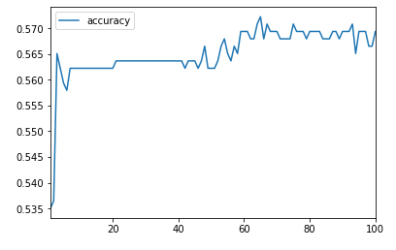

Accuracy Data Analysis
The data reveals that the accuracy of our model improves over the epochs however, accurately scaling the y axis data would demonstrate a consistent accuracy over the epochs

Slide 7
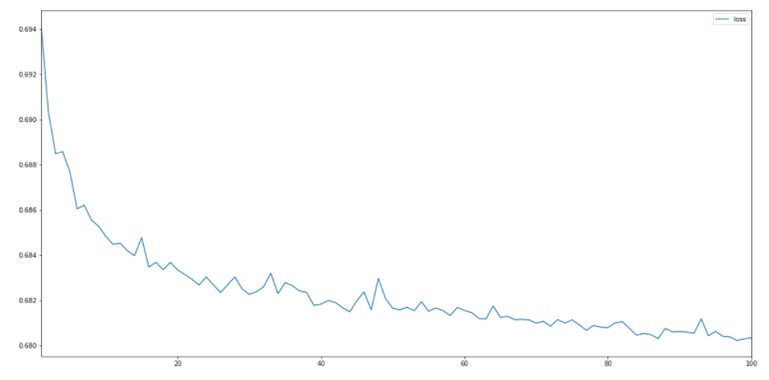
Loss Analysis
The data reveals that losses in the portfolio improves over the epochs however, accurately scaling the y axis data would demonstrate an insignificant change in losses over the epochs.

Slide 8
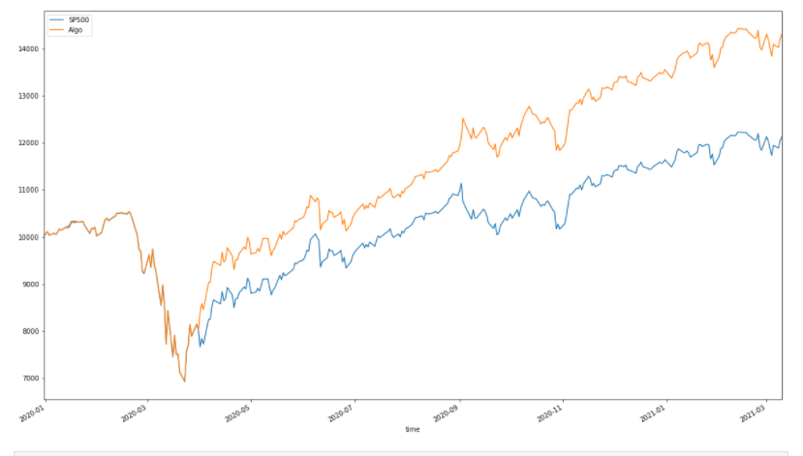
S&P500 vs Algorithm Cumulative returns
Initial investment of $10,000 demonstrates that our algorithm outperformed the S&P500 by > 20%. However, it is important to understand that returns will closely model the performance of the underlining asset.

Slide 9
Core Questions
Can we iteratively improve the model accuracy by analyzing additional Time Series data and/or utilizing NLP to include additional features based on fundamental analysis?
Does the marketplace have additional signals/features that could have been utilize to enhance results (i.e., twitter, satellite feeds, etc.)?
Does one particular feature have a greater impact than the other?

Slide 10


Questions?

